Slide 1





CITB IMPACT FUND – Timber in Construction

Slide 2

PROJECT START – OCTOBER 2025
CITB
Impact fund - £430k
The project aims to address critical skills gaps in the UK timber construction sector by developing accredited training, piloting delivery methods, and measuring impact.
https://www.be-st.build/news/citb-awards-430k-impact-funding-to-accelerate-low-carbon-timber-construction
PROJECT PARTNERS:

Slide 3
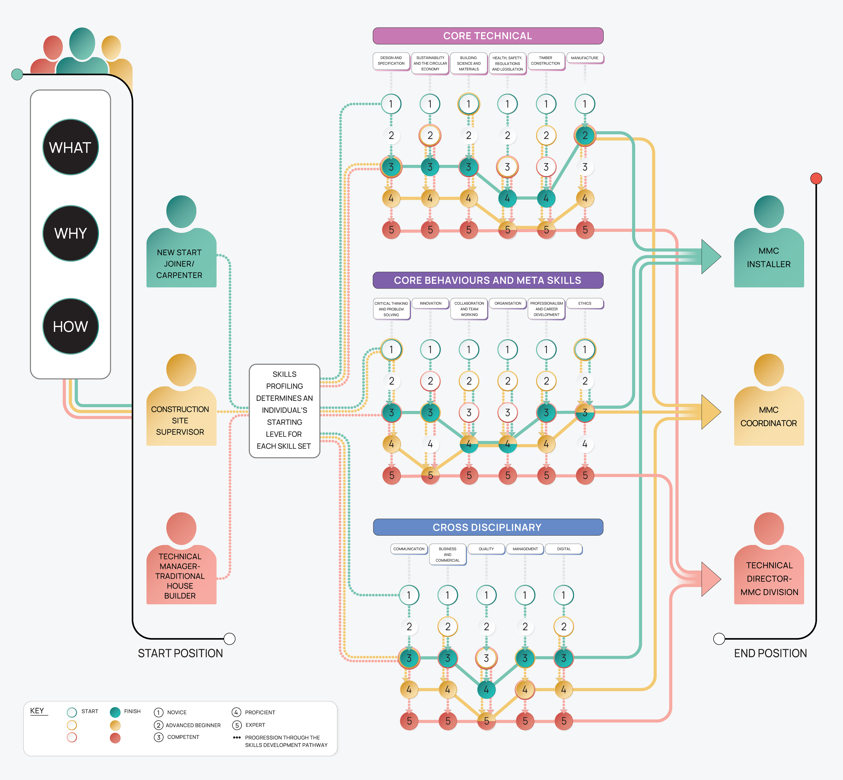
Standardised knowledge and consistent understanding
A quality assured and blended curriculum
Flexible pathways to upskilling and reskilling

Slide 4
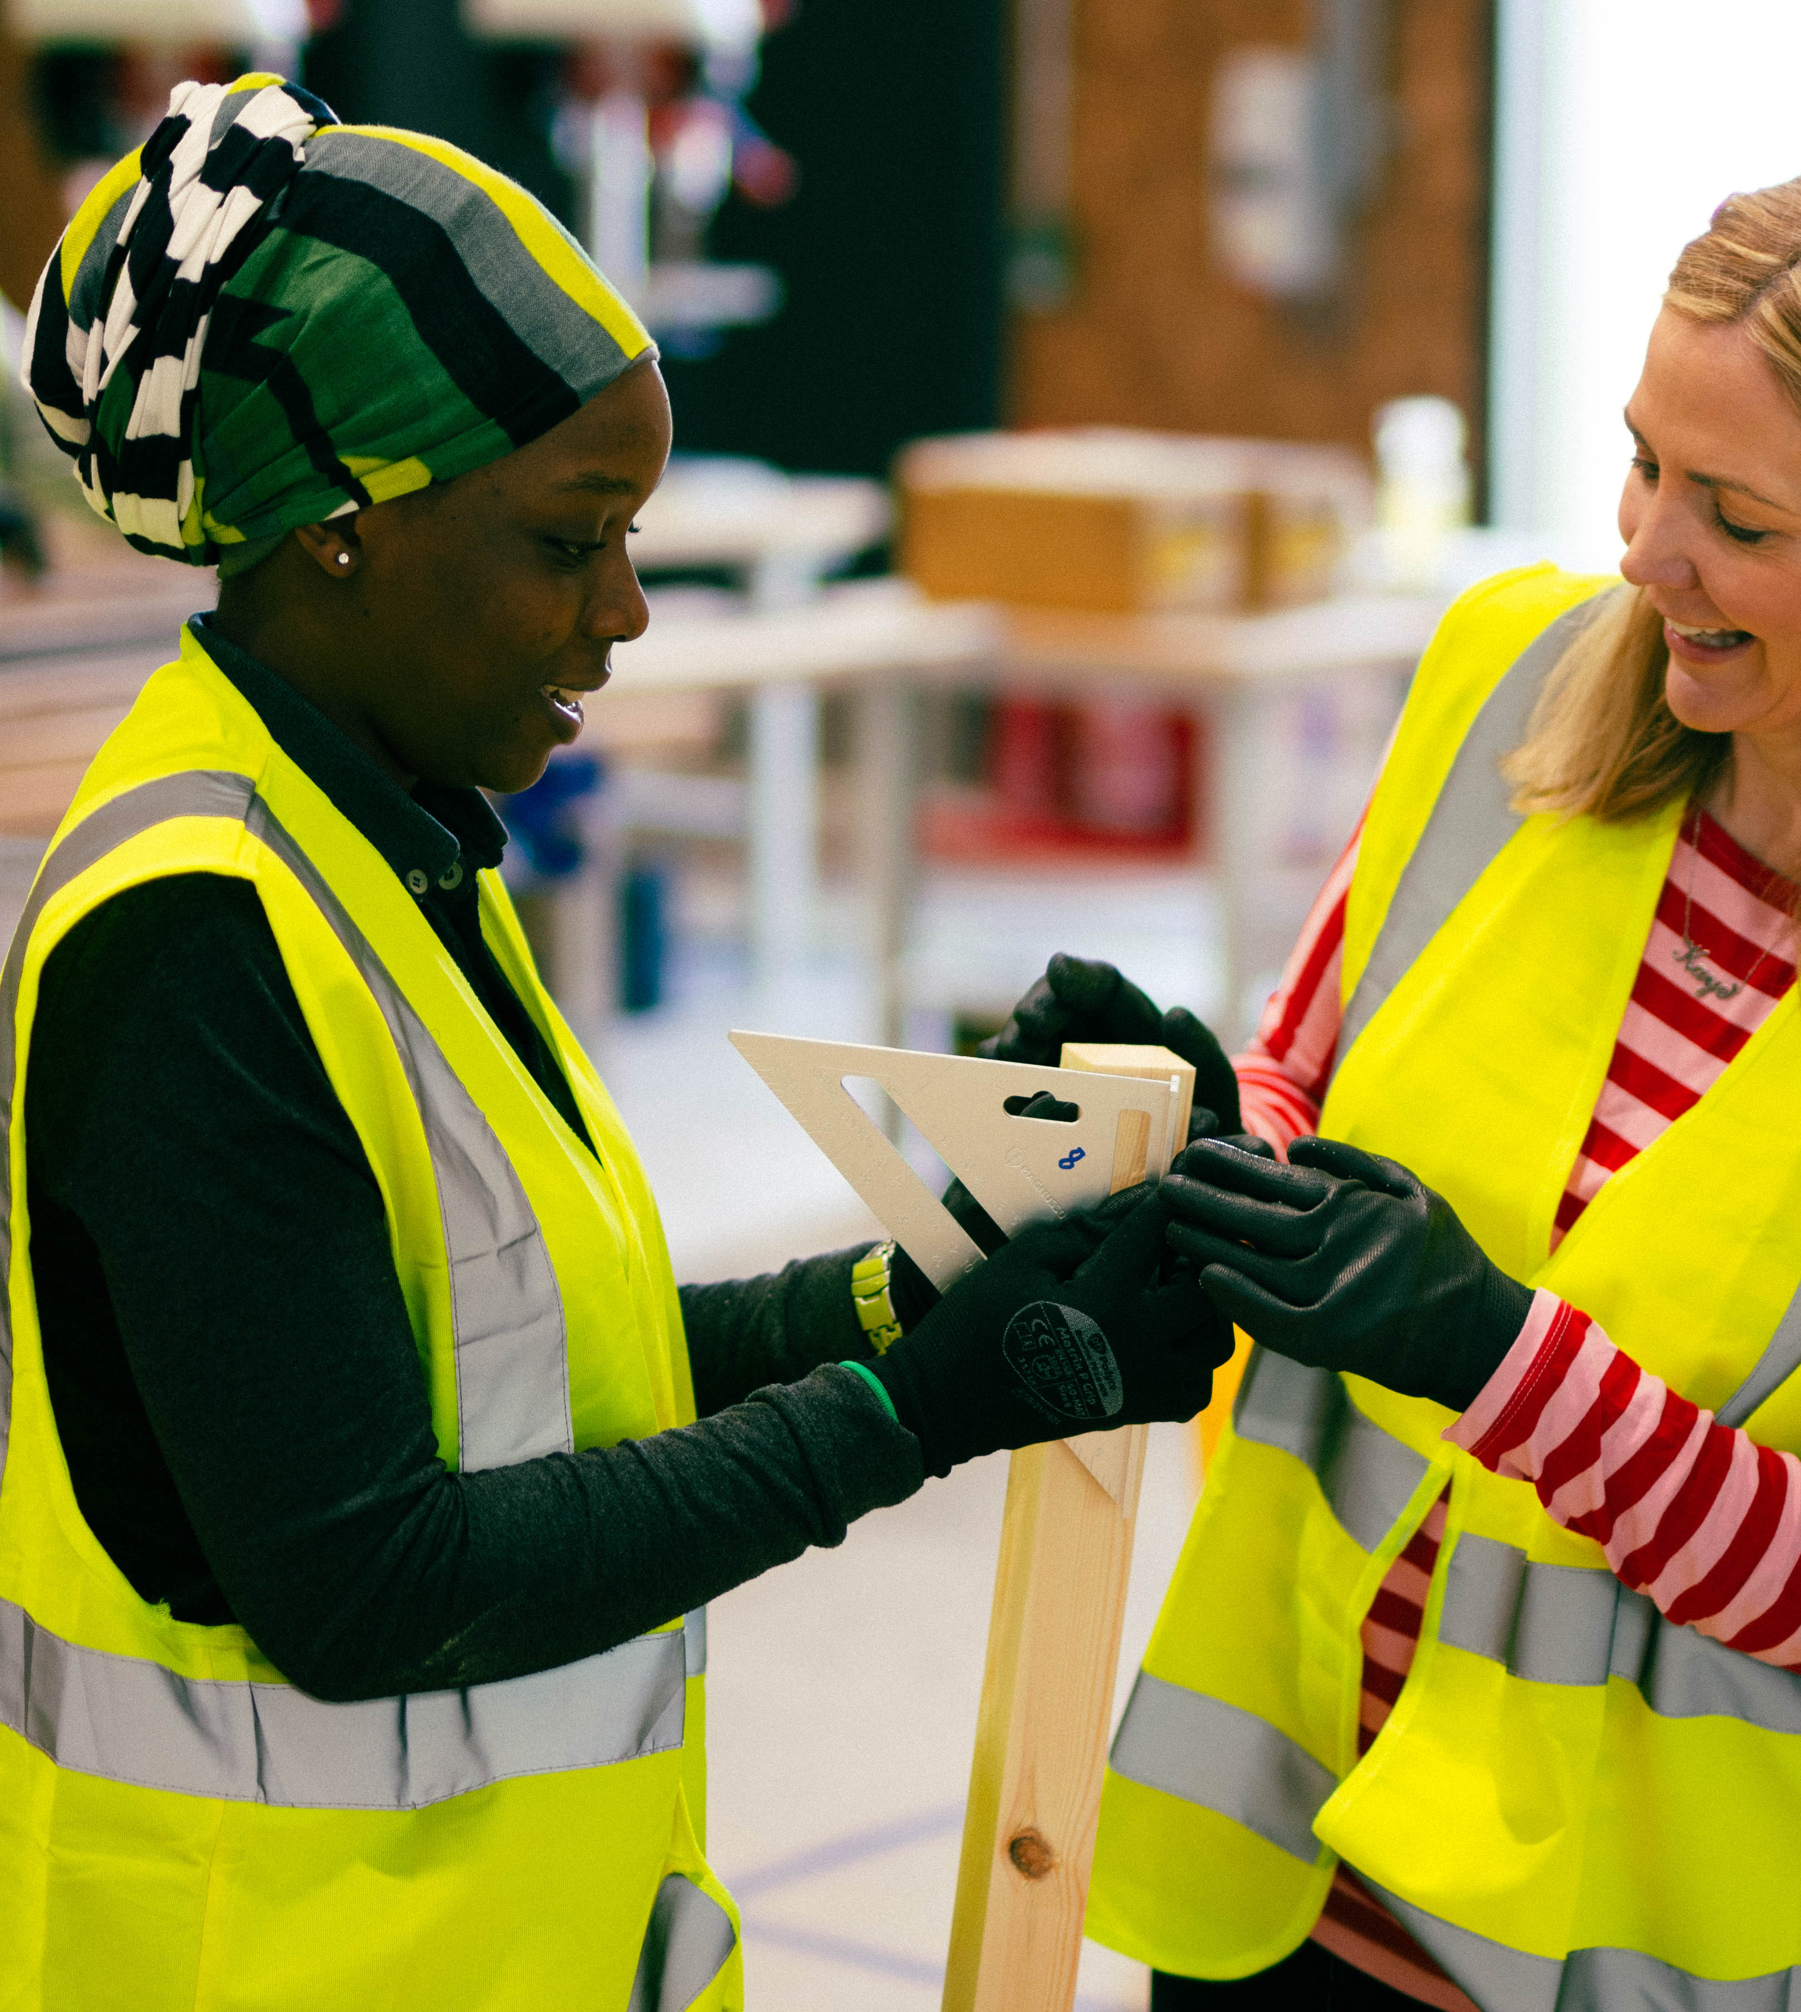
Impact
Strengthened ties between education providers and the sector
Standardised knowledge and consistent understanding
A quality assured and blended curriculum
Flexible pathways to upskilling and reskilling
Trained trainers & learning hubs in multiple UK localities
Ever-increasing number of competent workers trained annually
Continuous reduction in the skills gap
Inclusive future-ready workforce
Timber MMC increased and continuously improved
Sustainable construction forms as standard

Slide 5
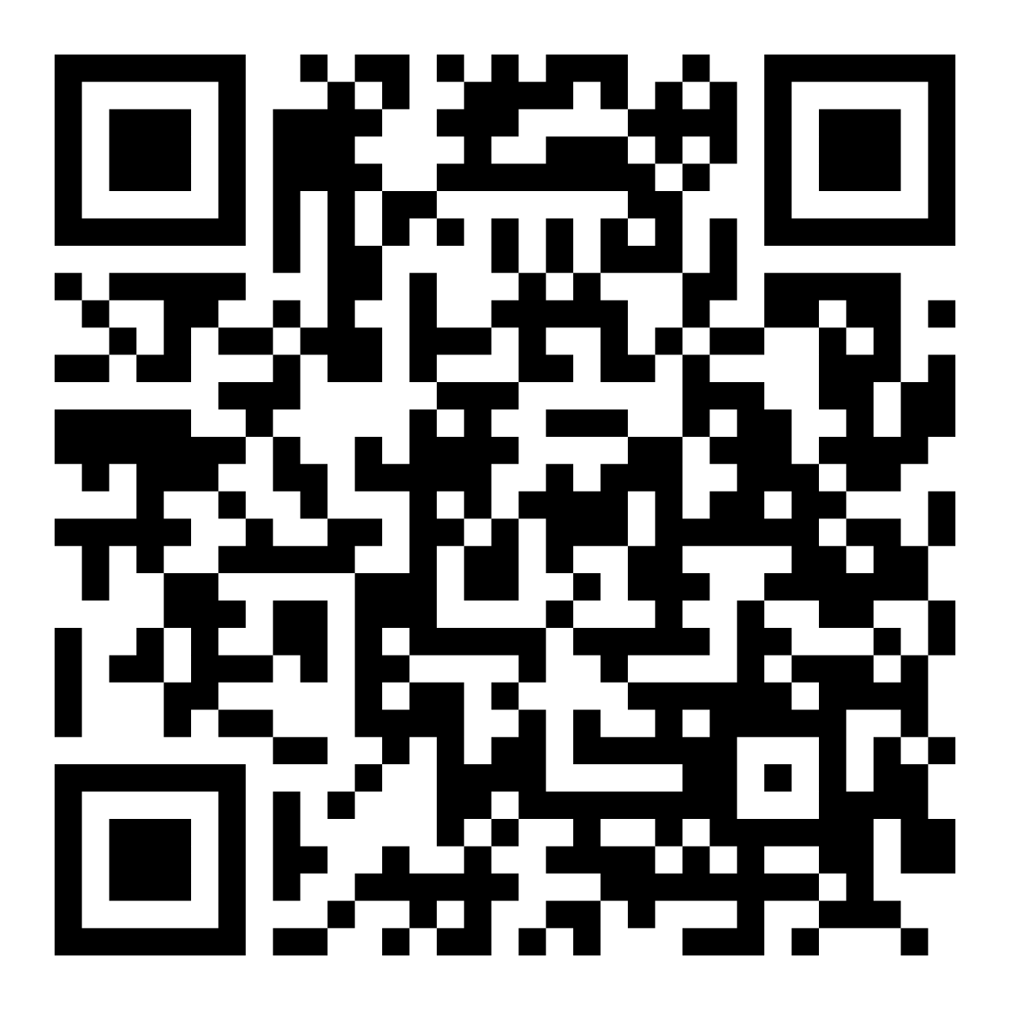


Question?
https://www.be-st.build/timber-in-construction-skills

