Slide 1

BACH Conference
19 May 2022
Funding the Training for Construction's Future
Coventry Central Hall
Warwick Lane, Coventry CV1 2HA

Slide 2

Industry Requirements
Mark Reynolds
Mace Group Chairman and Chief Executive

Slide 3
Industry requirements
The Industry Skills Plan
What does the Industry really want
The challenges the industry faces
Create a system that works for everyone
Questions

Slide 4


Slide 5

What does the industry really want
COMPETENT

Slide 6

What does the industry really want
CULTURE CHANGE

Slide 7
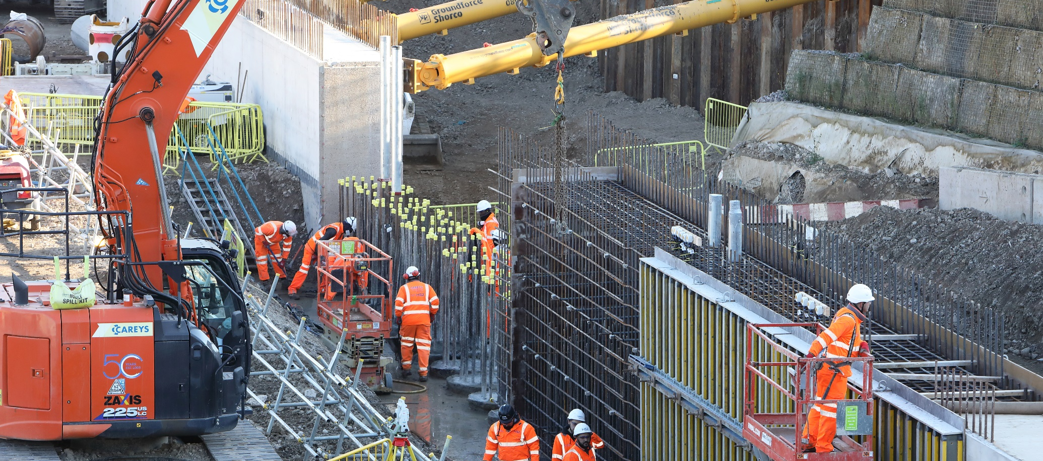
What does the industry really want
CAPACITY

Slide 8

The challenges the industry faces

Slide 9
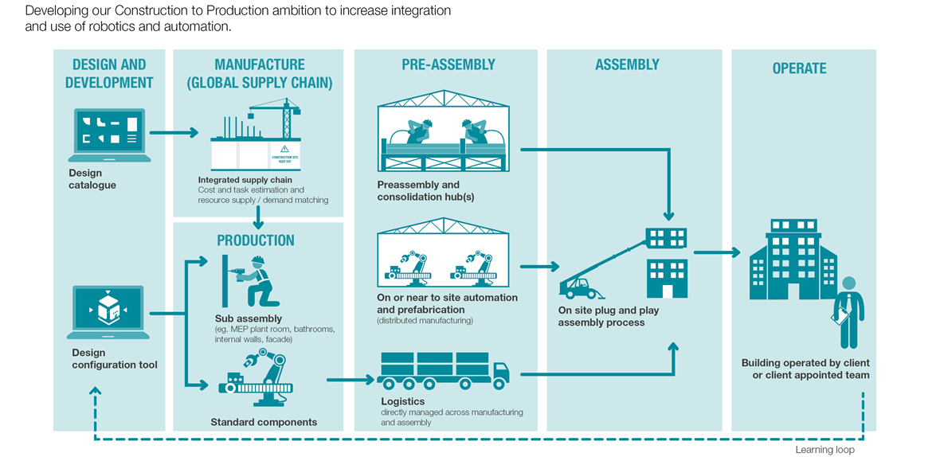
Create a system that works for everyone

Slide 10
questions

